Slide 1

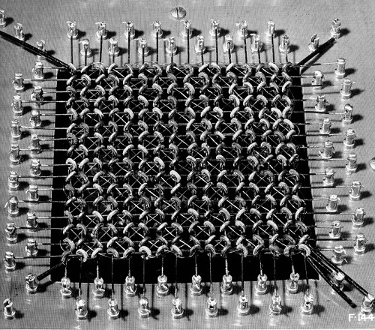
CISC360 Computer Architecture
Lesson 3
Internal Memory and Caches

Slide 2
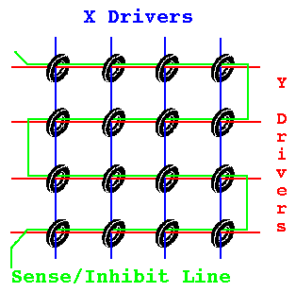
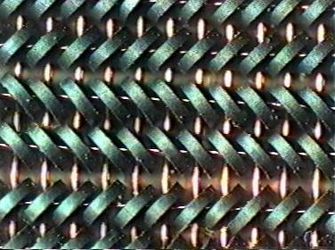
Ferrite Core Memory

Slide 3
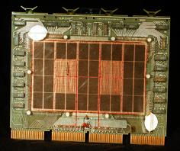
Ferrite Core Stack
16Kword PDP-11
Core Module

Slide 4

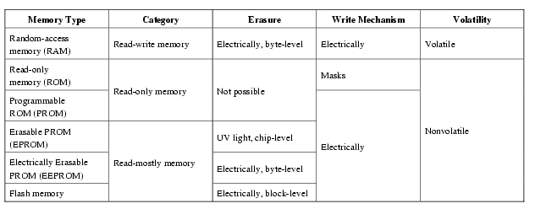
Semiconductor Memory Types

Slide 5
Semiconductor Memory
RAM
  Misnamed as all semiconductor memory is random access
  Read/Write
  Volatile
  Temporary storage
  Static or dynamic

Slide 6
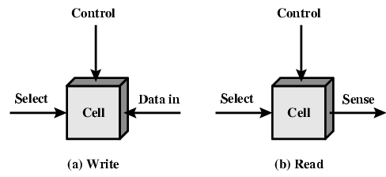
Memory Cell Operation

Slide 7
Dynamic RAM
Bits stored as charge in capacitors
Charges leak
Need refreshing even when powered
Simpler construction
Smaller per bit
Less expensive
Need refresh circuits
Slower
Main memory
Essentially analogue
  Level of charge determines value

Slide 8
DRAM Operation
Address line active when bit read or written
  Transistor switch closed (current flows)
Write
  Voltage to bit line
    High for 1 low for 0
  Then signal address line
    Transfers charge to capacitor
Read
  Address line selected
    transistor turns on
  Charge from capacitor fed via bit line to sense amplifier
    Compares with reference value to determine 0 or 1
  Capacitor charge must be restored

Slide 9
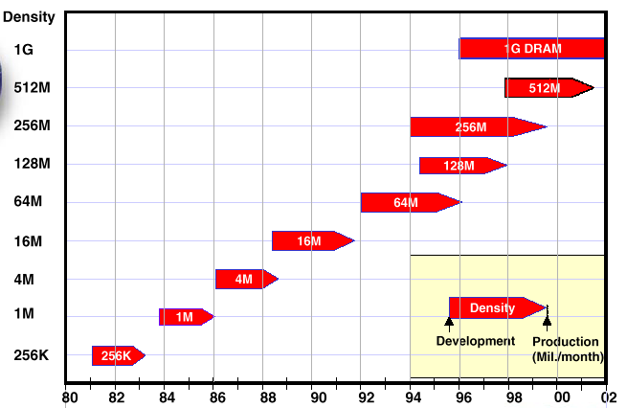
Memory Density
Courtesy: Advanced Memory International, Inc.

Slide 10
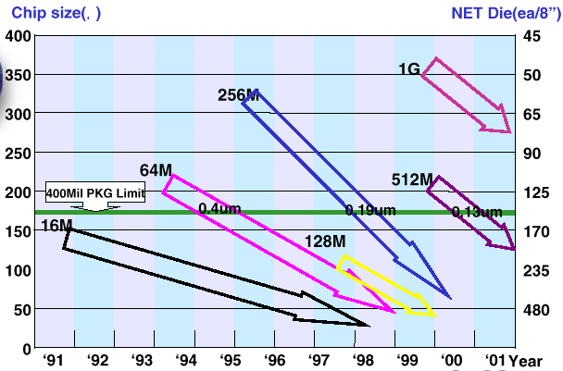
DRAM Density
Courtesy: Advanced Memory International, Inc.

Slide 11
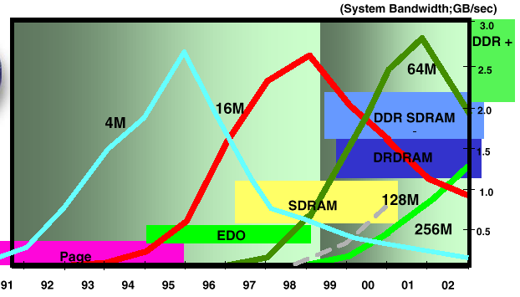
DRAM Technology
Courtesy: Advanced Memory International, Inc.

Slide 12
Static RAM
Bits stored as on/off switches
No charges to leak
No refreshing needed when powered
More complex construction
Larger per bit
More expensive
Does not need refresh circuits
Faster
Cache
Digital
  Uses flip-flops

Slide 13
SRAM v DRAM
Both volatile
  Power needed to preserve data
Dynamic cell
  Simpler to build, smaller
  More dense
  Less expensive
  Needs refresh
  Larger memory units
Static
  Faster
  Cache

Slide 14
Read Only Memory (ROM)
Permanent storage
  Nonvolatile
Microprogramming (see later)
Library subroutines
Systems programs (BIOS)
Function tables

Slide 15
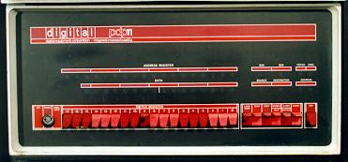
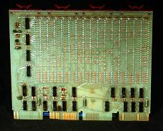
Types of ROM
Written during manufacture
  Very expensive for small runs
Programmable (once)
  PROM
  Needs special equipment to program
Read “mostly”
  Erasable Programmable (EPROM)
    Erased by UV
  Electrically Erasable (EEPROM)
    Takes much longer to write than read
  Flash memory
    Erase whole memory electrically

Slide 16
Organization in detail
A 16Mbit chip can be organised as 1M of 16 bit words
A bit per chip system has 16 lots of 1Mbit chip with bit 1 of each word in chip 1 and so on
A 16Mbit chip can be organised as a 2048 x 2048 x 4bit array
  Reduces number of address pins
    Multiplex row address and column address (WHY?)
    11 pins to address (2¹¹=2048)
    Adding one more pin doubles range of values so x4 capacity

Slide 17
Class Question
Why do we multiplex data and addresses?
What is the performance impact?

Slide 18
Refreshing
Refresh circuit included on chip
Disable chip
Count through rows
Read & Write back
Takes time
Slows down apparent performance

Slide 19
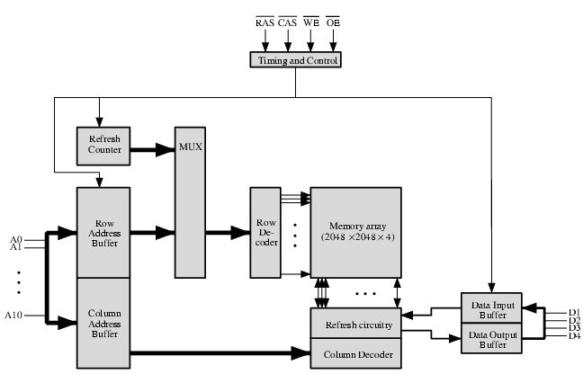
Typical 16 Mb DRAM (4M x 4)

Slide 20
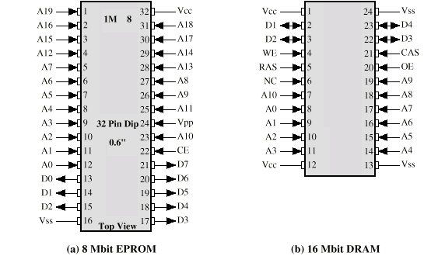
Packaging

Slide 21
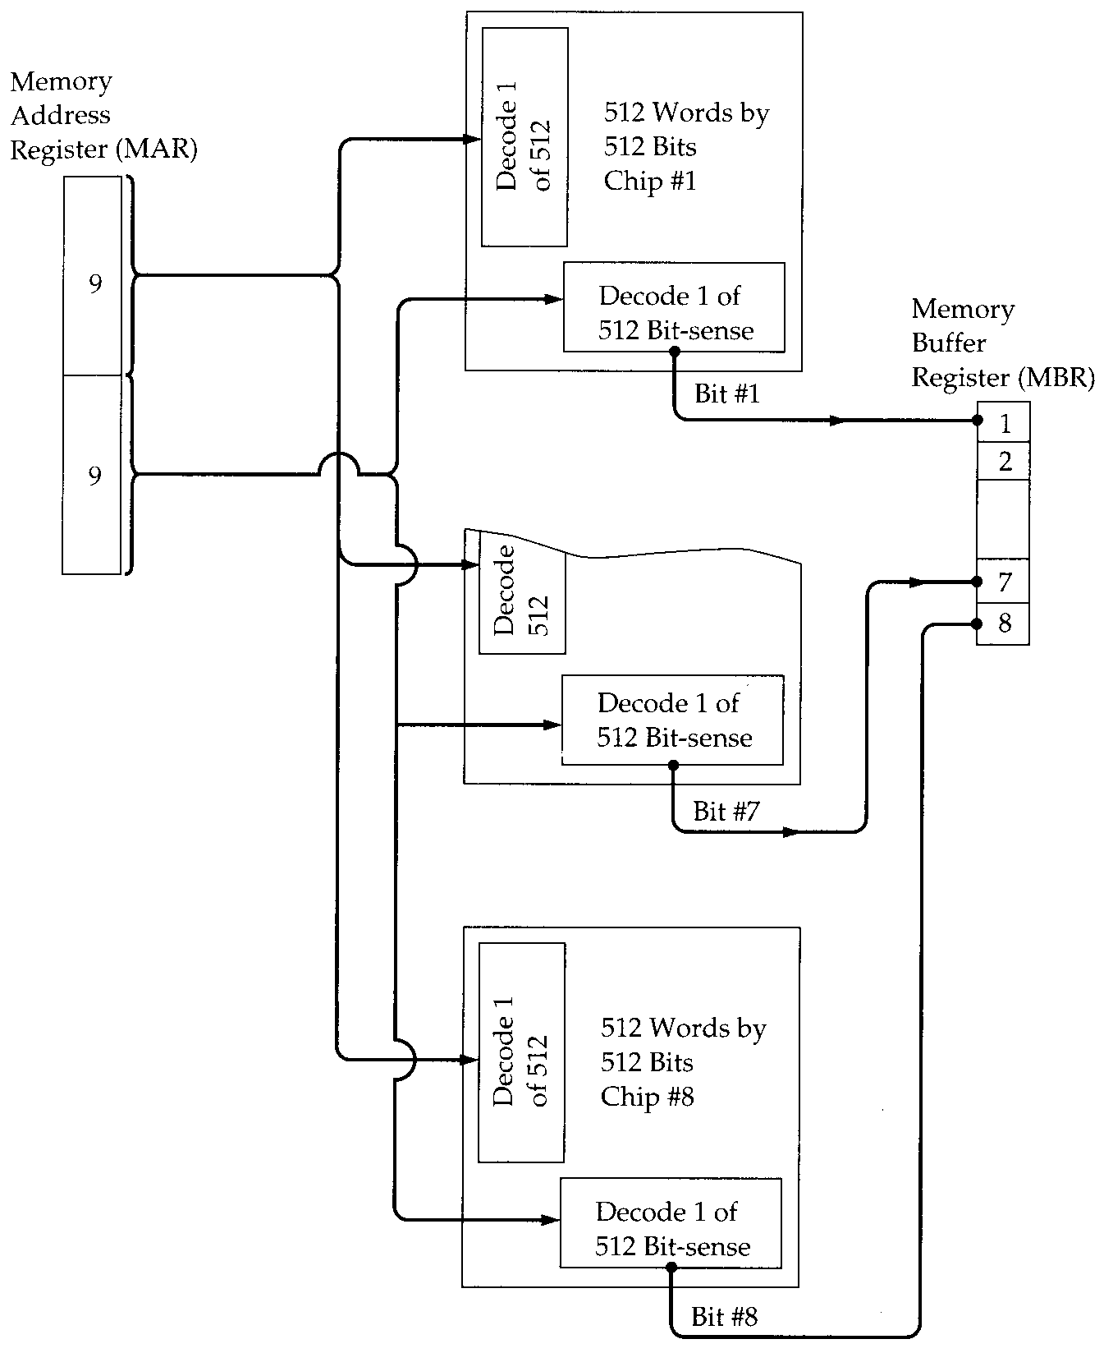
Module
Organization

Slide 22
Error Correction
Hard Failure
  Permanent defect
Soft Error
  Random, non-destructive
  No permanent damage to memory
Detected using Hamming error correcting code
Many modern systems track memory errors
  Why?
  What do you do with the information?

Slide 23
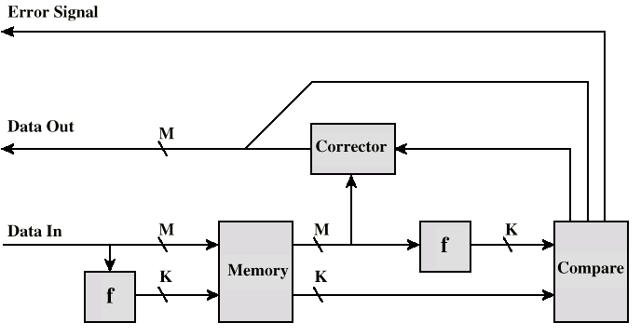
Error Correcting Code Function

Slide 24
Advanced DRAM Organization
Basic DRAM same since first RAM chips
Enhanced DRAM
  Contains small SRAM as well
  SRAM holds last line read (c.f. Cache!)
Cache DRAM
  Larger SRAM component
  Use as cache or serial buffer

Slide 25
Synchronous DRAM (SDRAM)
Access is synchronized with an external clock
Address is presented to RAM
RAM finds data (CPU waits in conventional DRAM)
Since SDRAM moves data in time with system clock, CPU knows when data will be ready
CPU does not have to wait, it can do something else
Burst mode allows SDRAM to set up stream of data and fire it out in block
DDR-SDRAM sends data twice per clock cycle (leading & trailing edge)

Slide 26
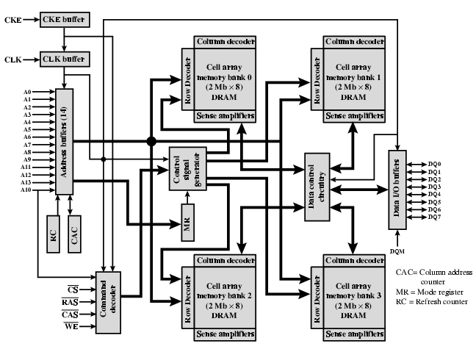
IBM 64Mb SDRAM

Slide 27
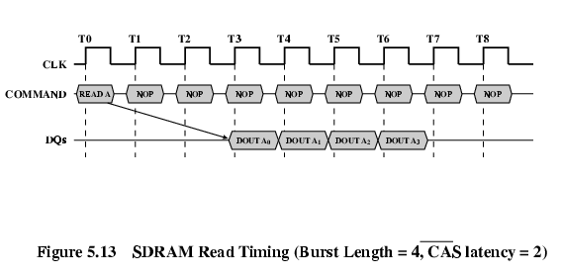
SDRAM Operation

Slide 28
RAMBUS
Adopted by Intel for Pentium & Itanium
Main competitor to SDRAM
Vertical package – all pins on one side
Data exchange over 28 wires < cm long
Bus addresses up to 320 RDRAM chips at 1.6Gbps
Asynchronous block protocol
  480ns access time
  Then 1.6 Gbps

Slide 29
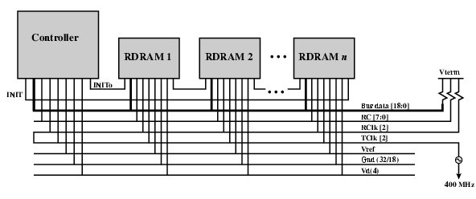
RAMBUS Diagram

Slide 30
Characteristics of Cache Memory
Location
Capacity
Unit of transfer
Access method
Performance
Physical type
Physical characteristics
Organisation

Slide 31
Cache Location
CPU
Internal
External

Slide 32
Cache Capacity
Word size
  The natural unit of organisation
Number of words
  or Bytes

Slide 33
Unit of Transfer
Internal
  Usually governed by data bus width
External
  Usually a block which is much larger than a word
Addressable unit
  Smallest location which can be uniquely addressed
  Word internally
  Cluster on M$ disks

Slide 34
Memory Access Methods (1)
Sequential
  Start at the beginning and read through in order
  Access time depends on location of data and previous location
  e.g. tape
Direct
  Individual blocks have unique address
  Access is by jumping to vicinity plus sequential search
  Access time depends on location and previous location
  e.g. disk

Slide 35
Memory Access Methods (2)
Random
  Individual addresses identify locations exactly
  Access time is independent of location or previous access
  e.g. RAM
Associative
  Data is located by a comparison with contents of a portion of the store
  Access time is independent of location or previous access
  e.g. cache

Slide 36

Memory Hierarchy
Registers
  In CPU
Internal or Main memory
  May include one or more levels of cache
  “RAM”
External memory
  Backing store

Slide 37
Memory Performance
Access time
  Time between presenting the address and getting the valid data
Memory Cycle time
  Time may be required for the memory to “recover” before next access
  Cycle time is access + recovery
Transfer Rate
  Rate at which data can be moved

Slide 38
Physical Types
Semiconductor
  RAM
Magnetic
  Disk & Tape
Optical
  CD & DVD
Others
  Bubble
  Hologram

Slide 39
Physical Characteristics
Decay
Volatility
Erasable
Power consumption

Slide 40
Organization
Physical arrangement of bits into words
Not always obvious
e.g. interleaved

Slide 41
The Bottom Line
How much?
  Capacity
How fast?
  Time is money
How expensive?

Slide 42
Hierarchy List
Registers
L1 Cache
L2 Cache
Main memory
Disk cache
Disk
Optical
Tape

Slide 43
So you want fast?
It is possible to build a computer which uses only static RAM (see later)
This would be very fast
This would need no cache
  How can you cache cache?
This would cost a very large amount

Slide 44
Locality of Reference
During the course of the execution of a program, memory references tend to cluster
e.g. loops

Slide 45

Cache
Small amount of fast memory
Sits between normal main memory and CPU
May be located on CPU chip or module

Slide 46
Cache operation - overview
CPU requests contents of memory location
Check cache for this data
If present, get from cache (fast)
If not present, read required block from main memory to cache
Then deliver from cache to CPU
Cache includes tags to identify which block of main memory is in each cache slot

Slide 47
Cache Design
Size
Mapping Function
Replacement Algorithm
Write Policy
Block Size
Number of Caches

Slide 48
Size does matter
Cost
  More cache is expensive
Speed
  More cache is faster (up to a point)
    CLASS QUESTION – What is the limit of cache size?
  Checking cache for data takes time

Slide 49

Typical Cache Organization

Slide 50
Mapping Function
Cache of 64kByte
Cache block of 4 bytes
  i.e. cache is 16k (2¹⁴) lines of 4 bytes
16MBytes main memory
24 bit address
  (2²⁴=16M)

Slide 51
Direct Mapping
Each block of main memory maps to only one cache line
  i.e. if a block is in cache, it must be in one specific place
Address is in two parts
Least Significant w bits identify unique word
Most Significant s bits specify one memory block
The MSBs are split into a cache line field r and a tag of s-r (most significant)

Slide 52
Direct Mapping
Address Structure
Tag s-r
Line or Slot r
Word w
8
14
2
24 bit address
2 bit word identifier (4 byte block)
22 bit block identifier
  8 bit tag (=22-14)
  14 bit slot or line
No two blocks in the same line have the same Tag field
Check contents of cache by finding line and checking Tag

Slide 53
Direct Mapping
Cache Line Table
Cache line Main Memory blocks held
0 0, m, 2m, 3m…2^{s}-m
1 1,m+1, 2m+1…2^{s}-m+1
m-1 m-1, 2m-1,3m-1…2^{s}-1

Slide 54
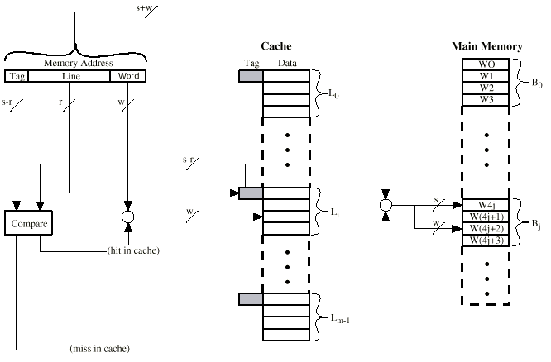
Direct Mapping Cache Organization

Slide 55
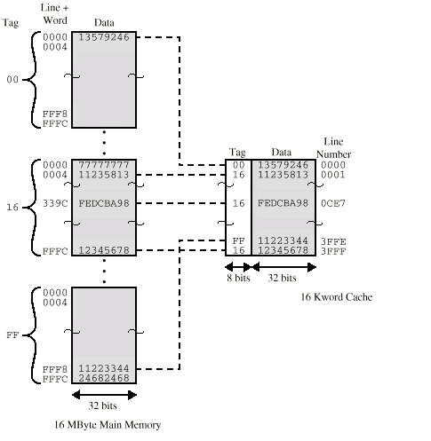
Direct Mapping Example

Slide 56
Direct Mapping Summary
Address length = (s + w) bits
Number of addressable units = 2^{s+w} words or bytes
Block size = line size = 2^{w} words or bytes
Number of blocks in main memory = 2^{s+ w}/2^{w} = 2^{s}
Number of lines in cache = m = 2^{r}
Size of tag = (s – r) bits

Slide 57
Direct Mapping pros & cons
Simple
Inexpensive
Fixed location for given block
  If a program accesses 2 blocks that map to the same line repeatedly, cache misses are very high

Slide 58
Associative Mapping
A main memory block can load into any line of cache
Memory address is interpreted as tag and word
Tag uniquely identifies block of memory
Every line’s tag is examined for a match
Cache searching gets expensive

Slide 59

Fully Associative Cache Organization

Slide 60
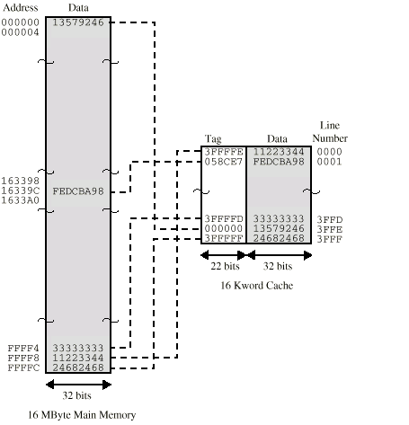
Associative Mapping Example

Slide 61
Associative Mapping
Address Structure
Word
2 bit
Tag 22 bit
22 bit tag stored with each 32 bit block of data
Compare tag field with tag entry in cache to check for hit
Least significant 2 bits of address identify which 16 bit word is required from 32 bit data block
e.g.
  Address Tag Data Cache line
  FFFFFC FFFFFC 24682468 3FFF

Slide 62
Associative Mapping Summary
Address length = (s + w) bits
Number of addressable units = 2^{s+w} words or bytes
Block size = line size = 2^{w} words or bytes
Number of blocks in main memory = 2^{s+ w}/2^{w} = 2^{s}
Number of lines in cache = undetermined
Size of tag = s bits

Slide 63
Set Associative Mapping
Cache is divided into a number of sets
Each set contains a number of lines
A given block maps to any line in a given set
  e.g. Block B can be in any line of set i
e.g. 2 lines per set
  2 way associative mapping
  A given block can be in one of 2 lines in only one set

Slide 64
Set Associative Mapping
Example
13 bit set number
Block number in main memory is modulo 2¹³
000000, 00A000, 00B000, 00C000 … map to same set

Slide 65
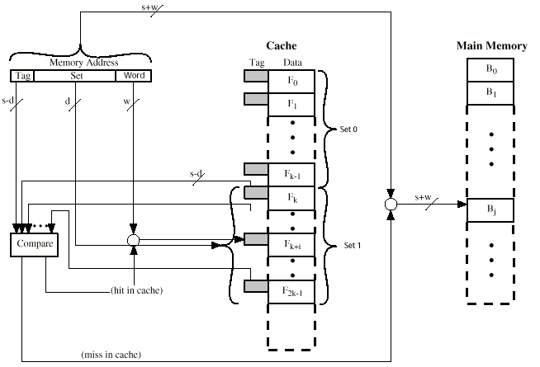
Two Way Set Associative Cache Organization

Slide 66
Set Associative Mapping
Address Structure
Word
2 bit
Tag 9 bit
Set 13 bit
Use set field to determine cache set to look in
Compare tag field to see if we have a hit
e.g
  Address Tag Data Set number
  1FF 7FFC 1FF 12345678 1FFF
  001 7FFC 001 11223344 1FFF

Slide 67
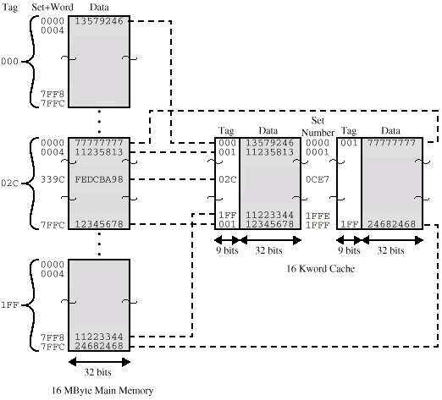
Two Way Set Associative Mapping Example

Slide 68
Set Associative Mapping Summary
Address length = (s + w) bits
Number of addressable units = 2^{s+w} words or bytes
Block size = line size = 2^{w} words or bytes
Number of blocks in main memory = 2^{d}
Number of lines in set = k
Number of sets = v = 2^{d}
Number of lines in cache = kv = k * 2^{d}
Size of tag = (s – d) bits

Slide 69
Replacement Algorithms (1)
Direct mapping
No choice
Each block only maps to one line
Replace that line

Slide 70
Replacement Algorithms (2)
Associative & Set Associative
Hardware implemented algorithm (speed)
Least Recently used (LRU)
e.g. in 2 way set associative
  Which of the 2 block is LRU?
First in first out (FIFO)
  replace block that has been in cache longest
Least frequently used
  replace block which has had fewest hits
Random

Slide 71
Write Policy
Must not overwrite a cache block unless main memory is up to date
Multiple CPUs may have individual caches
I/O may address main memory directly

Slide 72
Write through
All writes go to main memory as well as cache
Multiple CPUs can monitor main memory traffic to keep local (to CPU) cache up to date
Lots of traffic
Slows down writes
Remember bogus write through caches!

Slide 73
Write back
Updates initially made in cache only
Update bit for cache slot is set when update occurs
If block is to be replaced, write to main memory only if update bit is set
Other caches get out of sync
I/O must access main memory through cache
N.B. 15% of memory references are writes

Slide 74
Pentium 4 Cache
80386 – no on chip cache
80486 – 8k using 16 byte lines and four way set associative organization
Pentium (all versions) – two on chip L1 caches
  Data & instructions
Pentium 4 – L1 caches
  8k bytes
  64 byte lines
  four way set associative
L2 cache
  Feeding both L1 caches
  256k
  128 byte lines
  8 way set associative

Slide 75
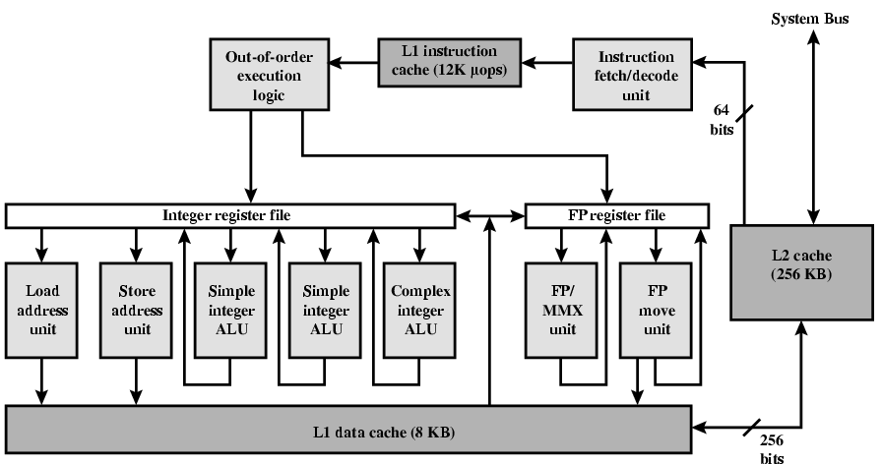
Pentium 4 Diagram (Simplified)

Slide 76
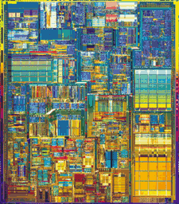
Pentium 4 Core Processor
Fetch/Decode Unit
  Fetches instructions from L2 cache
  Decode into micro-ops
  Store micro-ops in L1 cache
Out of order execution logic
  Schedules micro-ops
  Based on data dependence and resources
  May speculatively execute
Execution units
  Execute micro-ops
  Data from L1 cache
  Results in registers
Memory subsystem
  L2 cache and systems bus

Slide 77
Pentium 4 Design Reasoning
Decodes instructions into RISC like micro-ops before L1 cache
Micro-ops fixed length
  Superscalar pipelining and scheduling
Pentium instructions long & complex
Performance improved by separating decoding from scheduling & pipelining
  (More later – ch14)
Data cache is write back
  Can be configured to write through
L1 cache controlled by 2 bits in register
  CD = cache disable
  NW = not write through
  2 instructions to invalidate (flush) cache and write back then invalidate

